Slide 1

Object-oriented Programming with Ruby
Robert Batzinger
CSCI A-201
Spring 2009

Slide 2
Creating programs:
Getting classes to work together

Slide 3
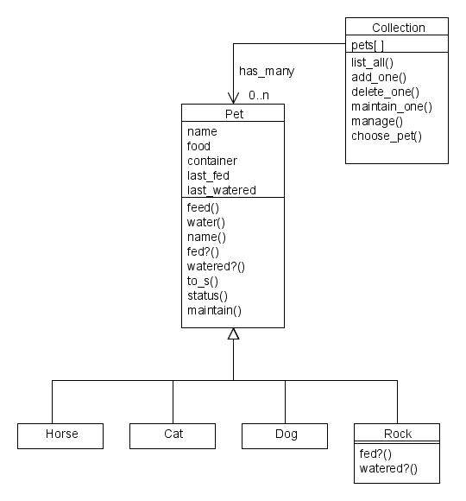
Design for tracking the feeding and watering of pets
Collection class contains a hash array of pets
Pet class is a critical abstract class with 4 subclasses
Rock class redefines some methods to override default behavior

Slide 4
Pet class
Attributes:
name, food, container, last_fed, last_watered
I/O Methods:
name, to_s, status,
Attribute change methods:
feed, water, maintain
Comparison methods:
fed?, watered?

Slide 5
User interface to Pet methods
def maintain
print "Choose an operation ([F]eed [W]ater [C]heck)“
op = gets().chomp()
case op
when 'C','c‘
puts "#{@name} #{status()}"
when 'W','w‘
water()
when 'F','f'
feed()
else
puts "Unknown command"
end
end
end

Slide 6
Collection class
Attribute: a hash to store and retrieve all pet data by pet name
Hash management methods:
Addition / deletion of pets
List all elements
User interface methods:
Selection of actions
Selection of a pet of focus

Slide 7
User interface
def manage_list
choice = '‘
until (choice == 'q') || (choice == 'Q‘) do print "User prompt:”
choice = gets().chomp! case choice
when 'A','a‘ puts 'Adding a pet‘ add_one() when 'D','d‘ puts 'Deleting a pet‘ delete_one()
else puts ‘bad option’
end
end
end
Prompt user
Get the user’s choice
Parse the choice
Run the appropriate method

Slide 8
Creating Pet instances within the Collection
User prompt
Grap name
User prompt
Grap type
Parse type
Create pet instance
Set the instance into the hash

Slide 9
Creating Pet instances within the Collection
def add_one
puts "Adding a new pet“
print 'Choose a name:‘
name = gets().chomp()
if @pets[name] != nil
puts “Name in use”
return nil
end
print "type [C]at [D]og”
type = gets().chomp()
case type
when 'C','c‘
pet = Cat.new(name)
when 'D','d'
pet = Dog.new(name)
else
puts ' Unknown pet type‘
return nil
end
@pets[name] = pet
end

Slide 10
Program lines
mypets = Collection.new()
mypets.manage
puts "... Good-bye"
Create an instance of the application
Activate the user interface
Log off

Slide 11
おわり The end

